Slide 1


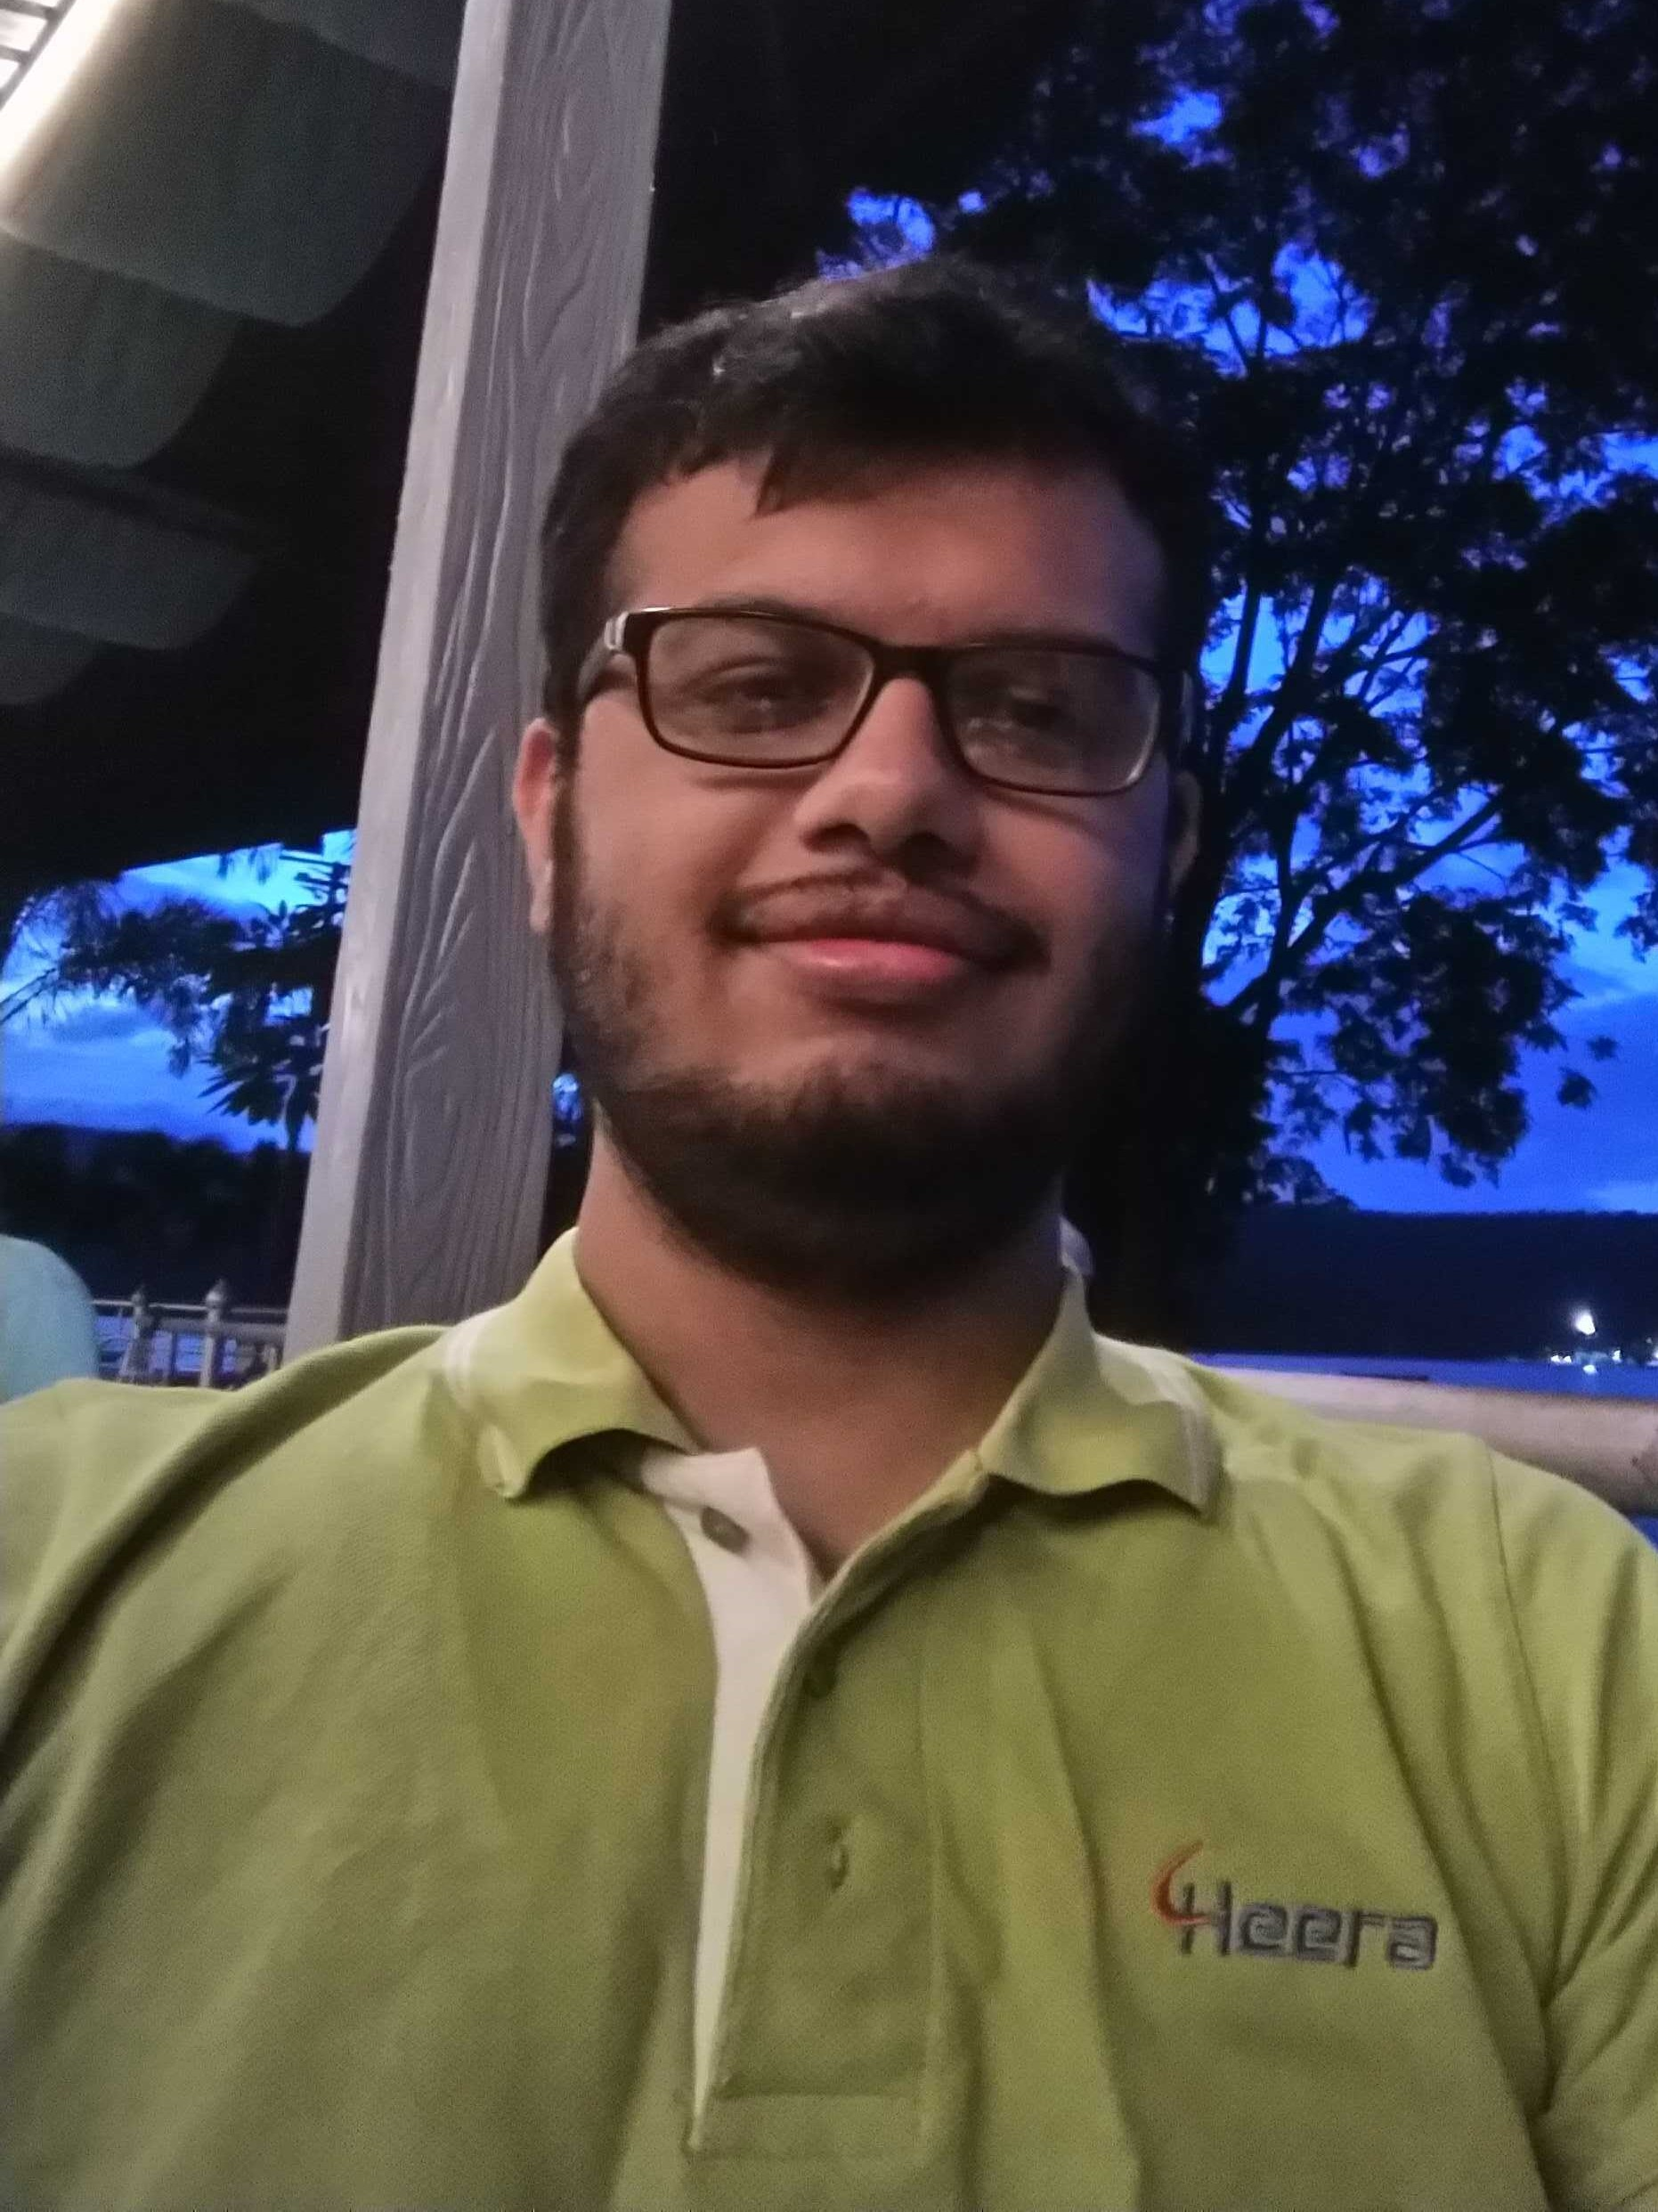
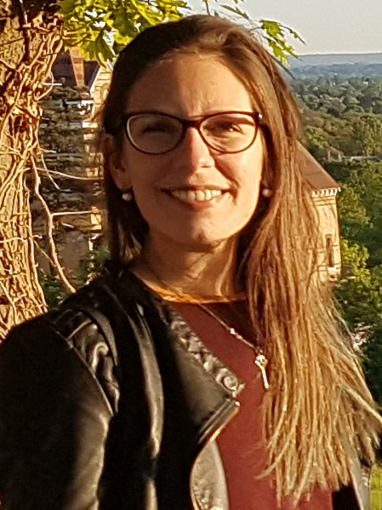
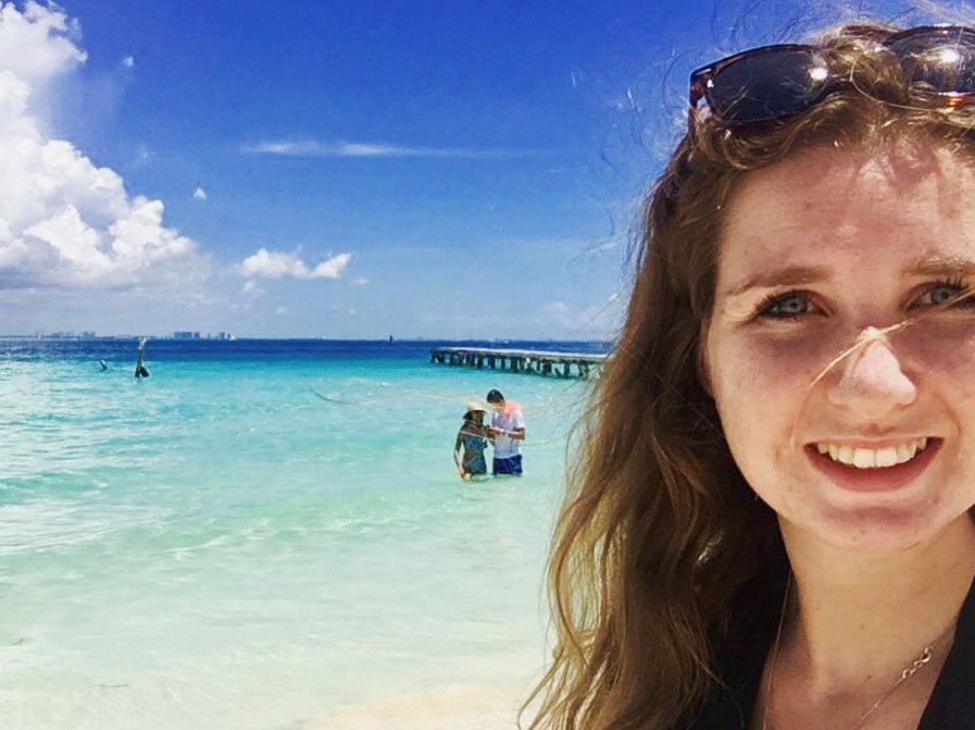
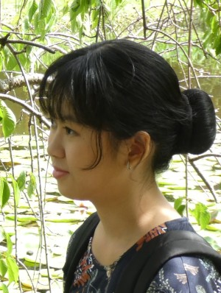
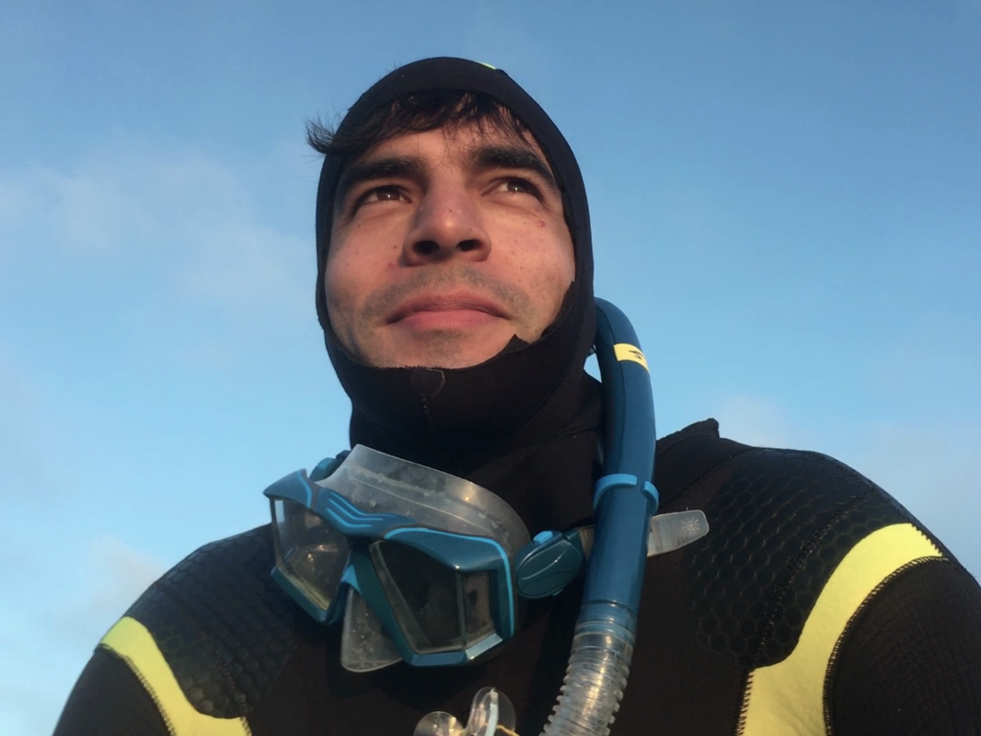
FruitPunch AI❤️
+ Kunal Geed
Soon to be Master in data science and AI, Eindhoven Uni of technology
Coral classification from sparse annotations
With thanks to: FruitPunch AI (info@fruitpunch.ai), Reef Support B.V., (hello@reef.support), ML Reef (Beta) (hello@mlreef.com)
Parth Dandavate
Final year IT student @ Pune Institute of Computer Technology
Julieta Millan
Zoologist and PhD student from Argentina
Kim van Asten
MSc. Neuroeconomics, now a Data Scientist in marketing
Nathanya Queby
Satriani AI student at Johannes Kepler University Linz
Leonard Meyer
MSc. in Marine Tropical Ecology University Bremen, Germany
1/7

Slide 2
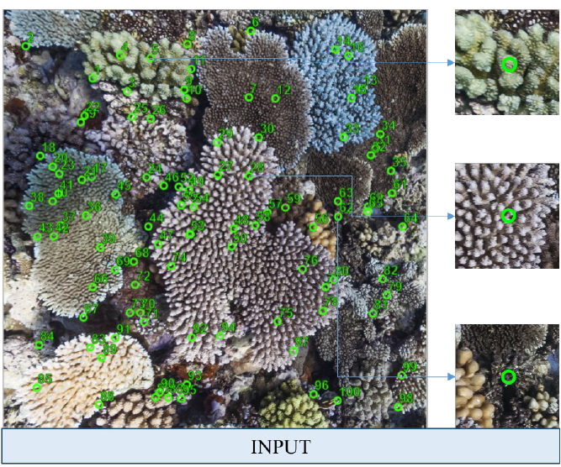
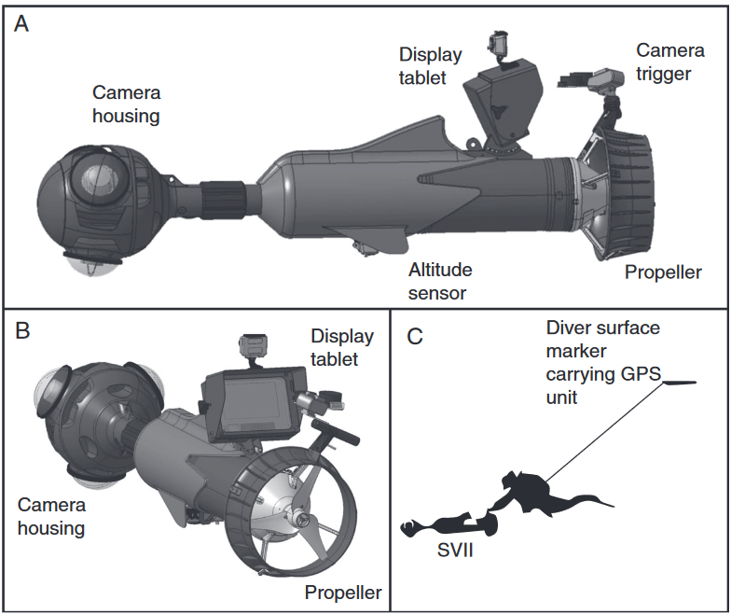
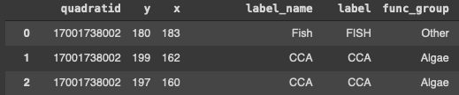
Goal // Data introduction
Diver vehicle and point data figure from González-Rivero et al. (2014)
Minimum goal: → Quantified coral presence/absence
Ultimately, generalized coral classification on species level across ocean regions (for automatized annotation we need accurate predictions)
Data = http://data.qld.edu.au/public/Q1281/
Caitlin Seaview Survey, > 11.000 images across 9 ocean regions
→ Sparse Ground Truth (50px / image)
2/7

Slide 3
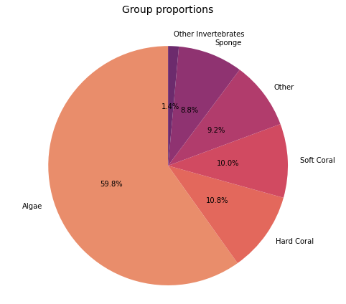
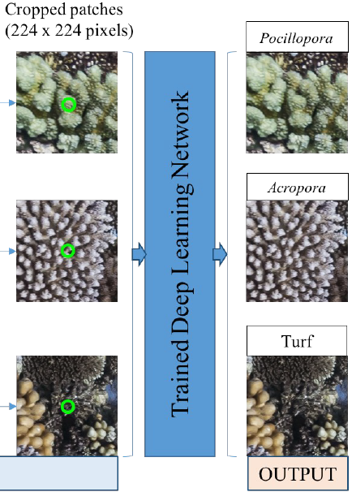
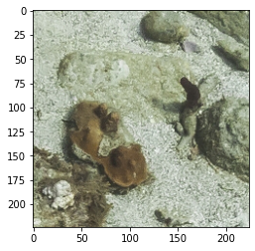
Pre-processing
Process concept figure from González-Rivero et al. (2014)
Imbalanced dataset (Assumption of equal sample size)
Accuracy not the best metric, inducing balance means undersampling some classes
Data augementation (flips etc.), only superficially expanding some classes might also not exclusively advantageous
CNN image input format → [224x224x3]
→ Cropped dense label annotations
Functional group 0
Functional group 1
Functional group 2
3/7
Notes:
Algae : Hard Coral => 5:1; (Slight… imbalance) The minority class is harder to predict because there are few examples of this class, by definition. This means it is more challenging for a model to learn the characteristics of examples from this class, and to differentiate examples from this class from the majority class

Slide 4
Work in progress …
Transfer learning → Pretrained NNs (ImageNet, ~14 mio. ‚worldly images‘)
VGGnet, Hugginface VIT
NumPy arrays saved as .h5py package → limited amount of images at a time, continuously occupies memory
Solved: PyTorch dataset class, processing fastest an easiest
→ GoogLeNet (CNN, Inception architecture)
(quite economic…trains faster than VGG …)
→ Requires input image normalization according to ImageNet data
4/7
Notes:
The other method would have been to crop out images around the points and save it. This would have taken up huge space. Imagine 50*number of orignal images. It would have also taken more memory to load these images for the model to process. But here we overwrite the get item method which basically get's called during runtime when a batch gets generated and image cropping takes place at that time. This saves lot of memory and some time also…
class that crops the images based on the annotation file each time the model is trained. The advantage is that using the GPU allows us to work with large volumes of data at the time, but since the images are constantly being manipulated it also takes longer to run the script.
Normalization (mean= [0.485, 0.456, 0.406], std = [0.229, 0.224, 0.225]) : they are using the mean and stddev of ImageNet, but if you look at their MNIST examples, the mean and stddev are 1-dimensional (since the inputs are greyscale-- no RGB channels).
VGG: We used a batch size of 32, Learning Rate of 1x10⁻³ , Adam optimizer, Cross Entropy Loss and started training with 2 Epochs.

Slide 5
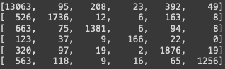
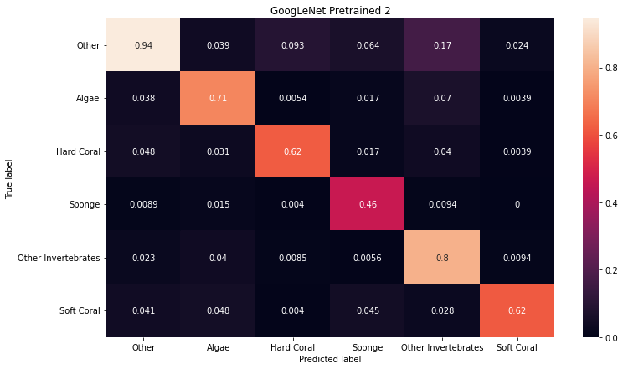
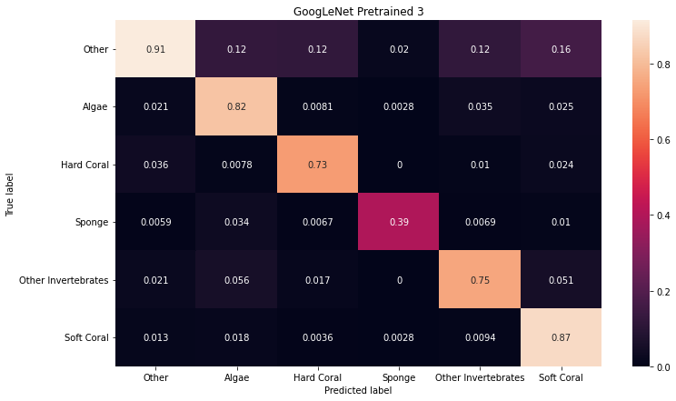
GoogLeNet // Results
GT
Predicted
Pretrained model→ fine-tuned FC Layer = 83,9% accurate
Save weights/optimzer function and run again (2hrs/epoch/one dataset)
→ Training again with saved weights => 4 epochs in total = ~86% accuracy
5/7
Notes:
We performed model fine-tuning by changing the last fully connected layer to fit our class number, and pre-processed the images as explained above. We used a batch size of 32, Learning Rate of 1x10⁻³ , Adam optimizer, Cross Entropy Loss and started training with 2 EpochsEpochs
75 train /25 test
Matrix is normalized! By the amount of total (observations) in the predicted (x) columns

Slide 6
Hurdles // Recommendations
Approach synthetical data and optimize image borders (mirroring)
Multiscale input, or alternative superpixel approaches
Benchmark datasets for tropical coral reefs?
Normalize for own mean and std (since coral reefs are probably not part of imagenet)
Large data sets programing reauires similar image dataset structure
Acquisition method should be uniform
Feasible goals, coarse resolution
Full image classification e.g. as habitat type or predominant benthos
(GoogLeNet peaked around 2014 ...)
6/7

Slide 7
References
González‐Rivero, M., Bongaerts, P., Beijbom, O., Pizarro, O., Friedman, A., Rodriguez‐Ramirez, A., ... & Hoegh‐Guldberg, O. (2014). The Catlin Seaview Survey–kilometre‐scale seascape assessment, and monitoring of coral reef ecosystems. Aquatic Conservation: Marine and Freshwater Ecosystems, 24(S2), 184-198. DOI: https://doi.org/10.1002/aqc.2505.
González-Rivero, M., Rodriguez-Ramirez, A., Beijbom, O., Dalton, P., Kennedy, E. V., Neal, B. P., ... & Hoegh-Guldberg, O. (2019). Seaview Survey Photo-quadrat and Image Classification Dataset. University of Queensland Library. DOI: https://doi.org/10.14264/uql.2019.930.
7/7

Slide 8
